Slide 1

AIRBNB HOTEL BOOKING ANALYSIS
Benganuru Jilan Basha INTERNSHIP_17546440516895be537820f

Slide 2

PROBLEM STATEMENT
This project develops a machine learning model to estimate Airbnb listing prices. Accurate pricing is crucial for hosts (increasing occupancy and income) and guests (finding reasonable rates). Using historical data, a regression model links listing characteristics (e.g., bedrooms, bathrooms, reviews) to price, enabling smarter pricing decisions for property owners.

Slide 3
Project Goal: Analyze Airbnb hotel booking data.
Objectives:
Identify trends and patterns.
Determine key factors influencing pricing.
Understand customer behavior across different locations.

Slide 4


WHO ARE THE END USERS?
Hosts aim for increased occupancy and income
Guests seek reasonable rates and optimal choices
Property owners make smarter pricing decisions

Slide 5
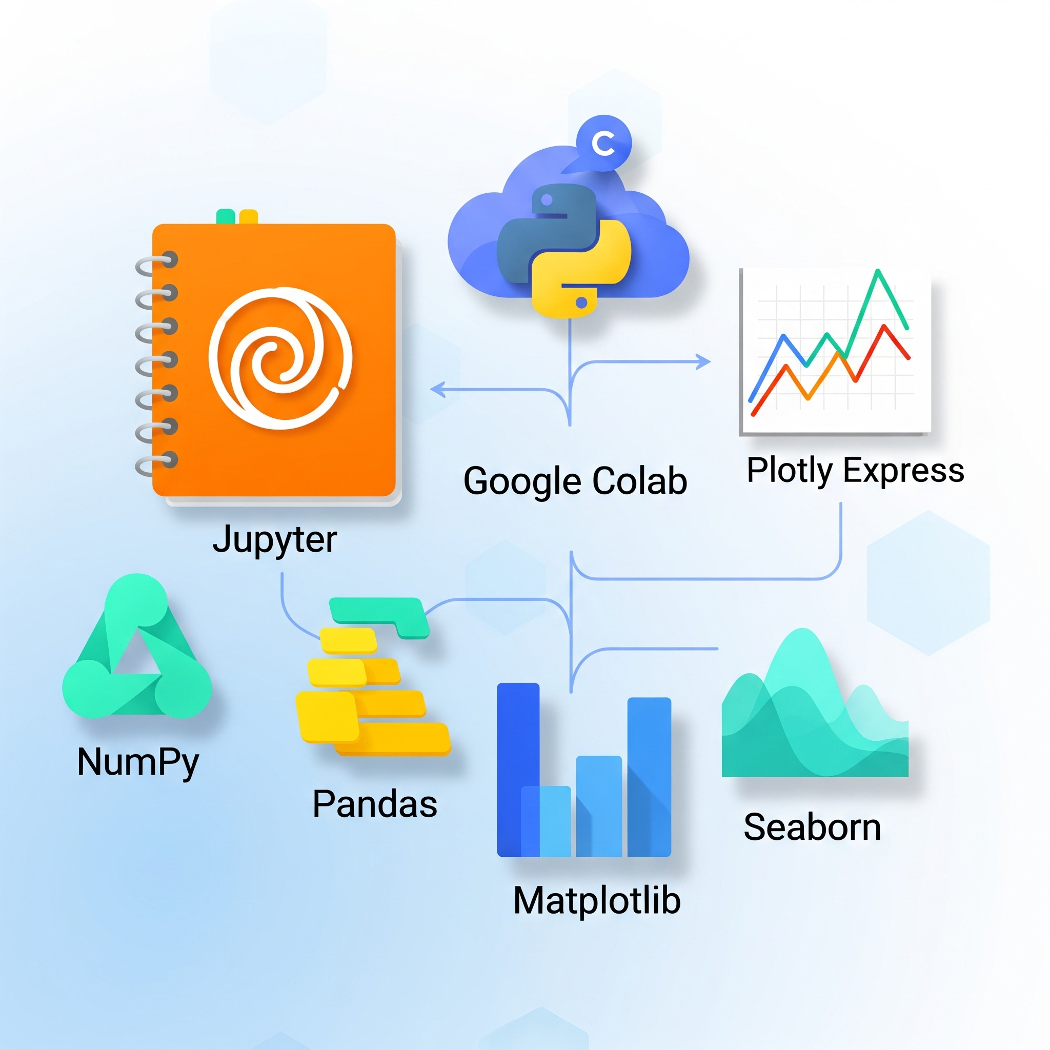
Technology Used
Jupyter and Google Colab for development
NumPy for numerical operations
Pandas for data manipulation and analysis
Matplotlib and Seaborn for data visualization
Plotly Express for interactive plots

Slide 6
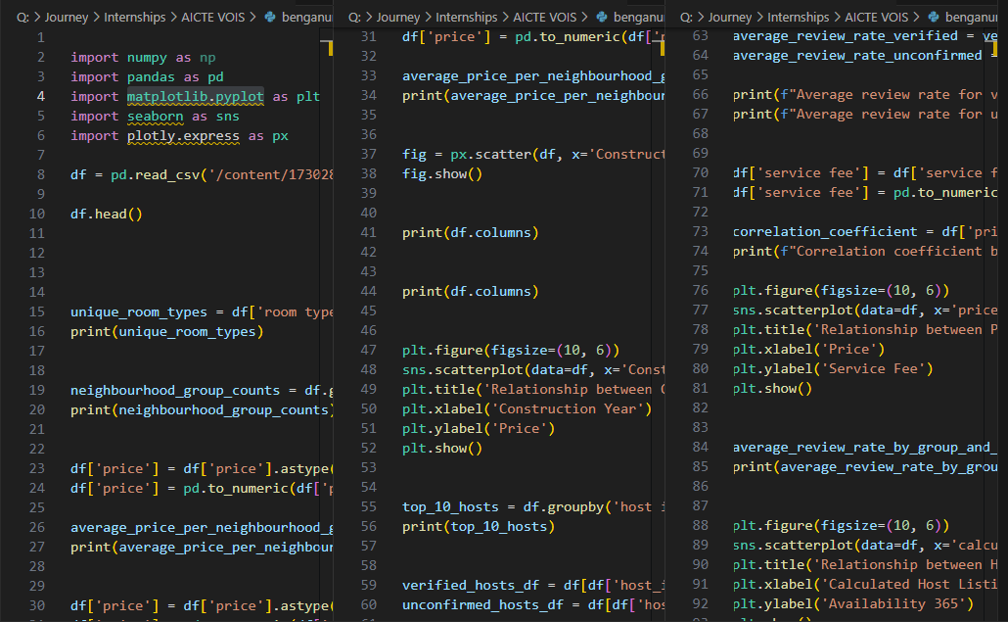
Python Code

Slide 7
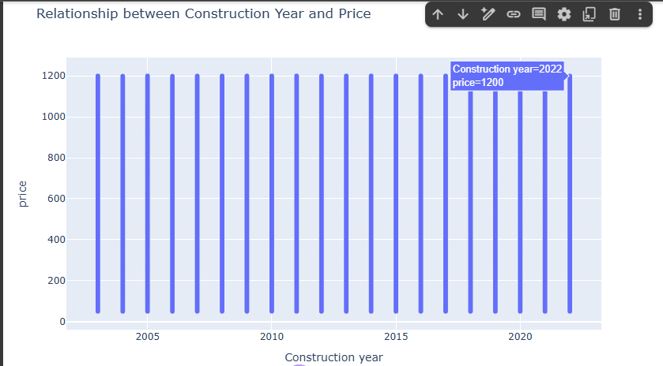
RESULTS1
Demo Link

Slide 8
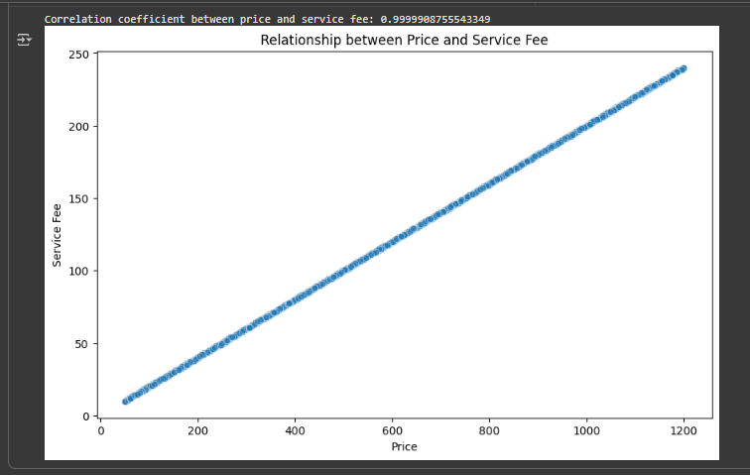
RESULTS2
Demo Link

Slide 9
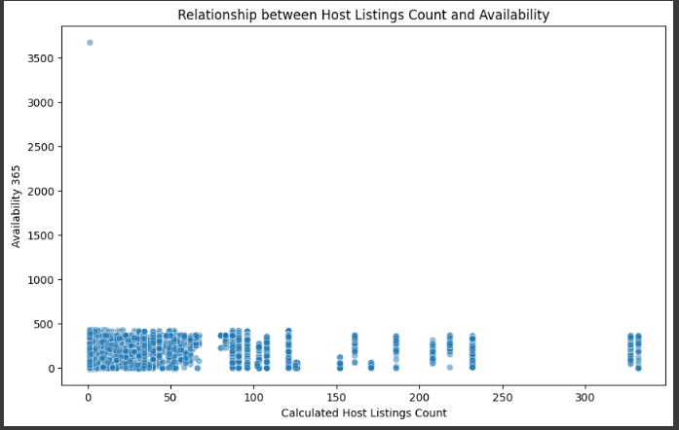
RESULTS3
Demo Link

Slide 10
GitHub repository
https://github.com/Jeelan80/VOIS_AICTE_Oct2025_Benganuru_Jilan_Basha.git
Demo Link

Slide 11
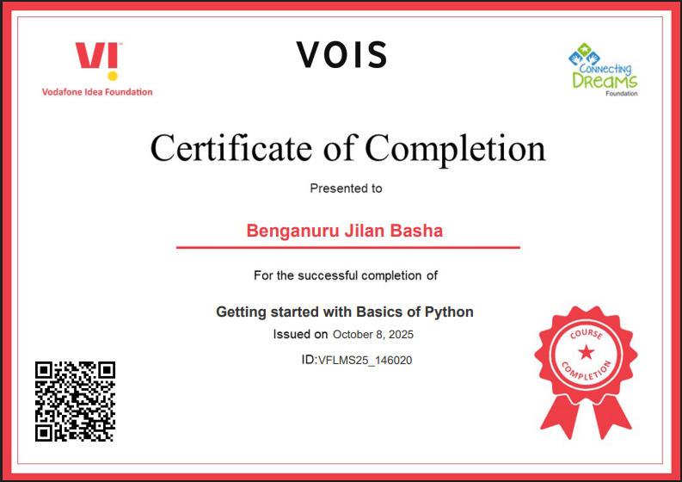
Getting started with Basics of Python Certificate

Slide 12
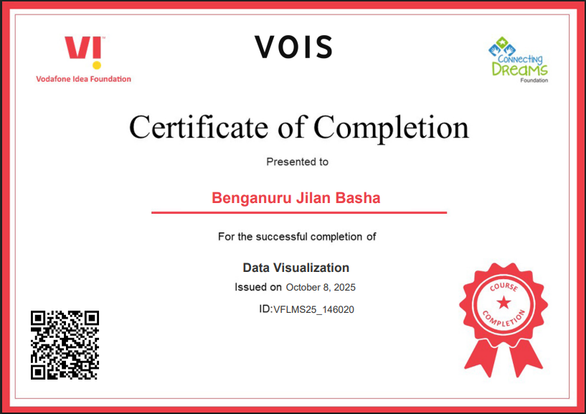
Data Visualization Certificate

Slide 13
Thank you
.
.

